Slide 1



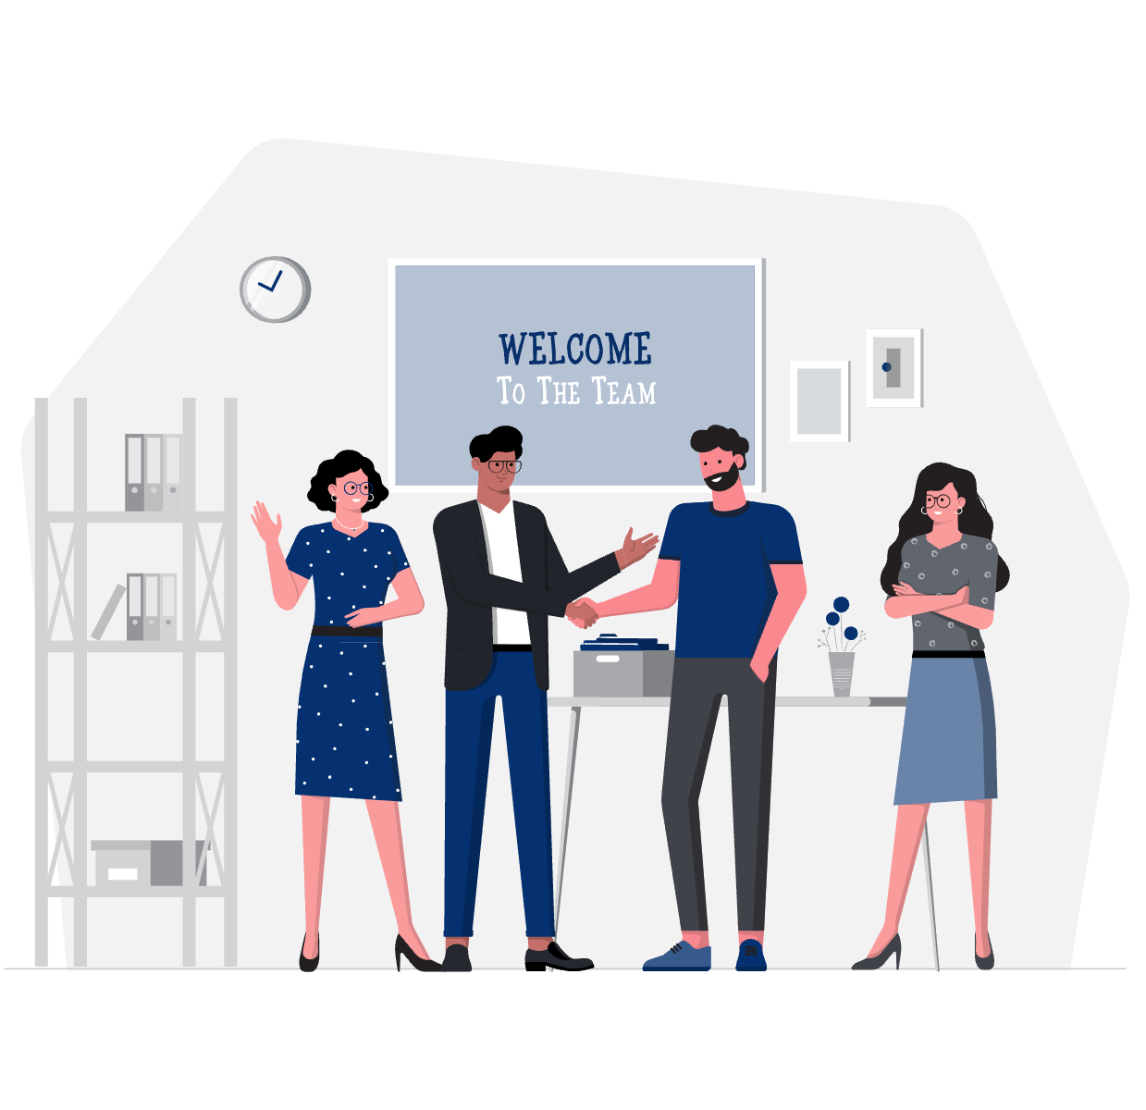
Web Framework Programming
Topic 6:
Designing your Website using Template
WEEK 06 Informatics Engineering
Universitas Surabaya
Informatics Engineering | Universitas Surabaya
Notes:
Cover Half
Gambar vector bisa didownload di: https://scale.flexiple.com/illustrations/
Jika ingin foto free royalty bisa download di: https://pixabay.com/photos/

Slide 2
Outline
1
2
3
4
Templating and Layout in Web Development
Defining your Layout Template
Defining your Child Template
Implementation using Existing Case Study
Informatics Engineering | Universitas Surabaya

Slide 3
Templating
Informatics Engineering | Universitas Surabaya

Slide 4
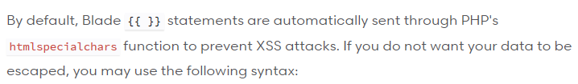
Templating
We will discuss how to use Custom HTML from a UI/UX designer into your Laravel Framework.
We use Blade Template (https://laravel.com/docs/10.x/blade#introduction)
Commonly used Template Syntax:
@section @endsection
@yield
@extends
{{ ….. }} -> displaying Data
{!! …….. !!}} -> Displaying Unescaped Data
@json (json encode to render json data)
Informatics Engineering | Universitas Surabaya

Slide 5
Templating
Templates, which embedded in the Laravel Framework, have various types according to their functions.
There are 2 types of templates: Administrative Templates (backend) and Public Templates (front-end).
The backend is part of the portal that is used for the administration of all data and is accessed by the company's internals. Usually has a simple UI/UX but displays complete and detailed data.
The front end is the part of the portal that is used to publish information to public. The main challenge is how to manage interactions with general users. Public Side has an attractive UI/UX and accommodated various kinds of interactions
The technique of installing templates both Front-end and Backend has the same method.
Informatics Engineering | Universitas Surabaya

Slide 6
Practice #1: Installing Templates in Our Project
Informatics Engineering | Universitas Surabaya

Slide 7
Steps
Search & download HTML templates
Extract the HTML template source code
Choose and Recognize Layouts that are used as the basic UI framework
Slicing Layout to determine which is the parent (base layout) and child blade
Apply Layouts and Child Templates in Laravel's Resources View
Customize child templates with existing templates
Integrate child templates with layout templates with @yield and @extends syntax
Integrate template assets in Laravel project path with @asset . syntax
Informatics Engineering | Universitas Surabaya

Slide 8
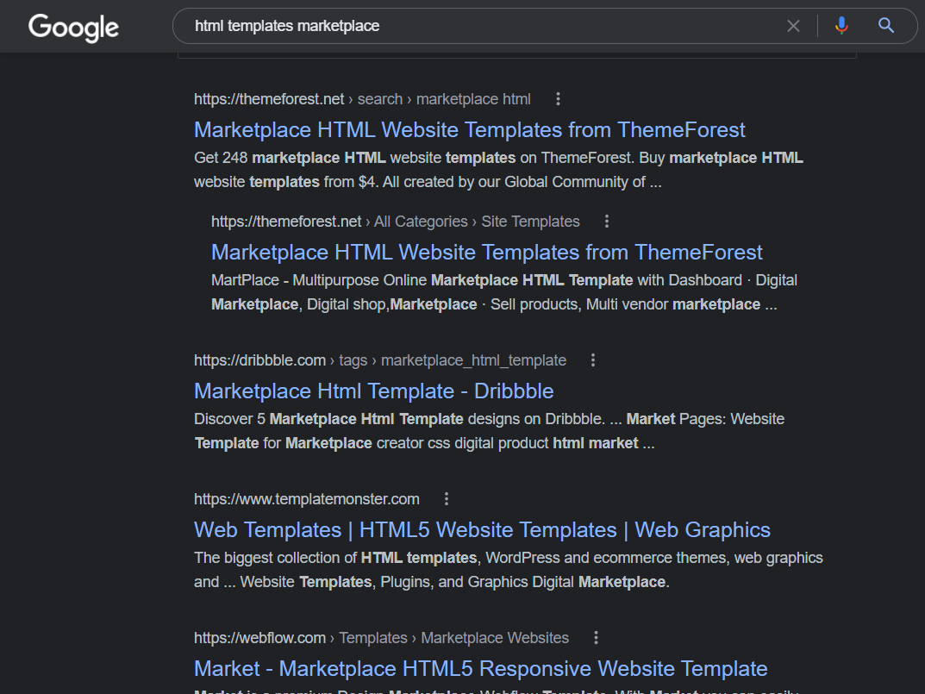
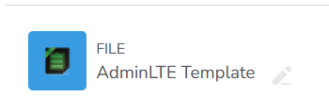
1. Find your Template
For this lesson, we already provided 1 template for you.
We use: AdminLTE
You can get custom Template from any resources like: themeforest, templatemonster, and so on.
Informatics Engineering | Universitas Surabaya

Slide 9
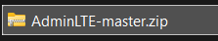
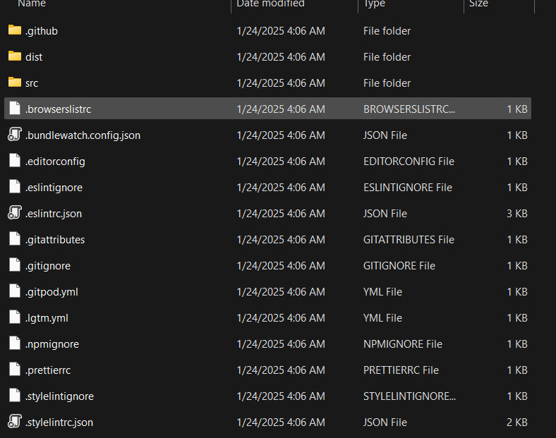
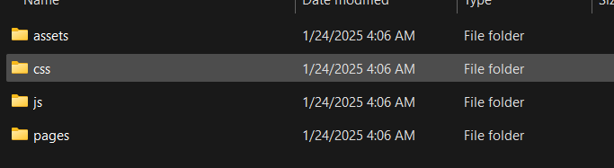
2. Extract source HTML
Copy and extract this zip
In AdminLTE, our layout is located on dist/pages.
Copy your element & assets template into directory public. In this case: assets, css and js inside dist directory
Informatics Engineering | Universitas Surabaya

Slide 10
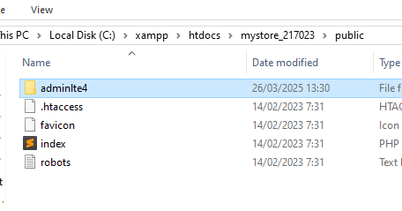
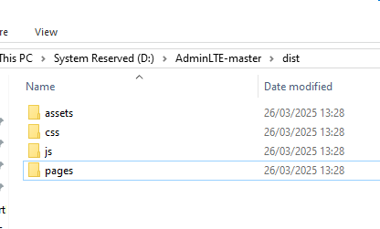

Slide 11
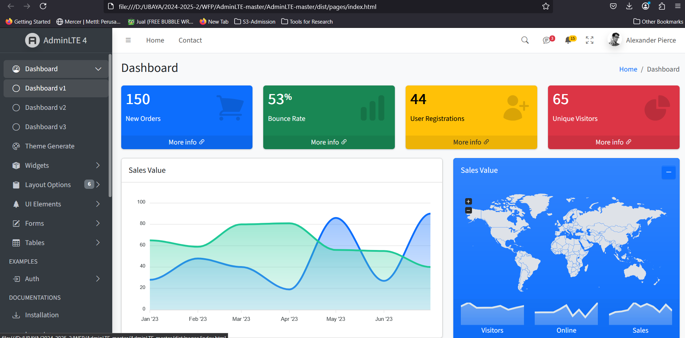
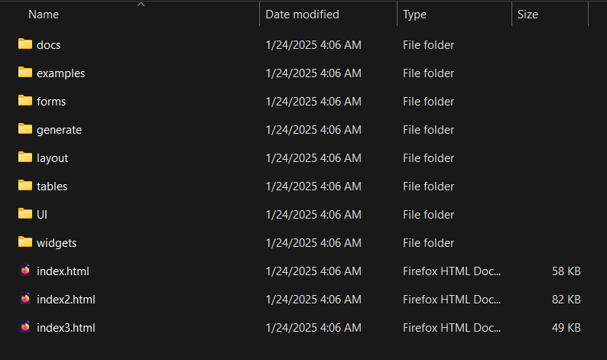
2. Extract source HTML (2)
Open your template and we analyze our `main` template. Open `index.html` in a web browser
Informatics Engineering | Universitas Surabaya

Slide 12
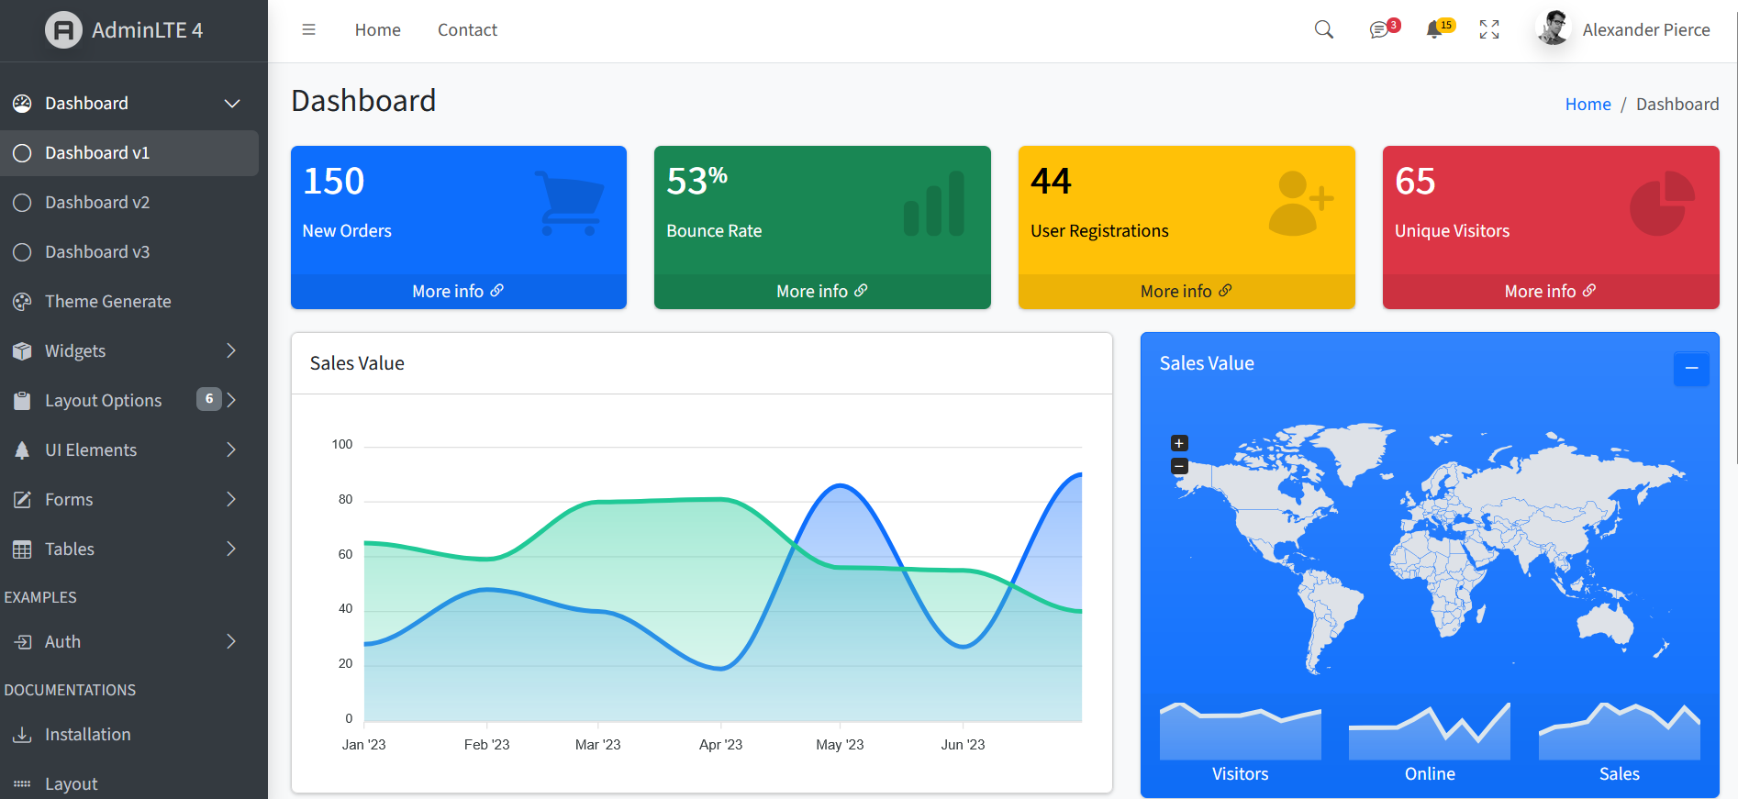
3. Identify your Layout
Informatics Engineering | Universitas Surabaya

Slide 13
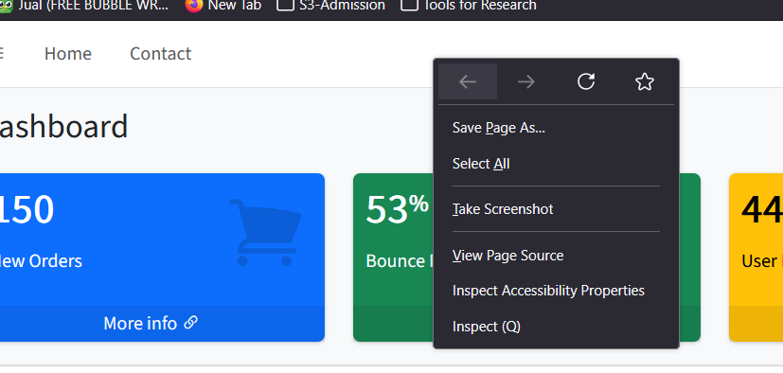
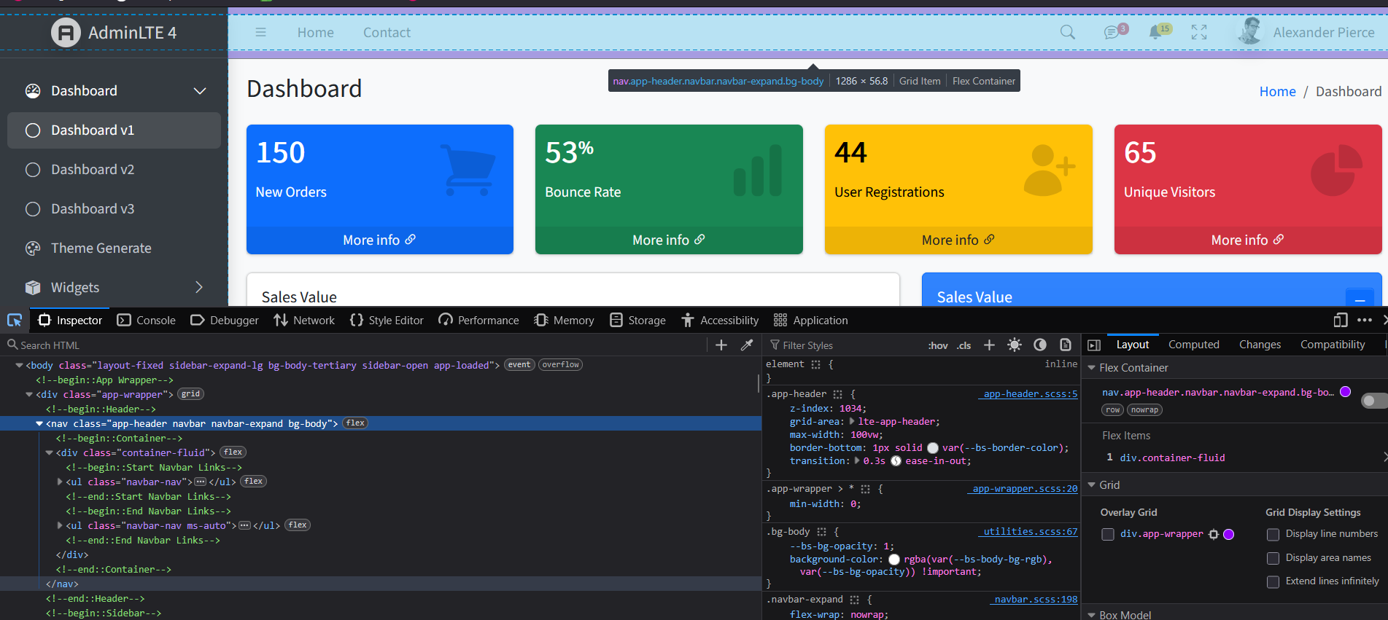
Layout Analysis: Headers
Use the Inspect Element help tool in each browser.
The header in AdminLTE is found as follows
The syntax or class declaring header is
<nav class="app-header navbar navbar-expand bg-body">
Use [Pick inspector] (Ctrl+Shift+C) at Firefox
Informatics Engineering | Universitas Surabaya

Slide 14
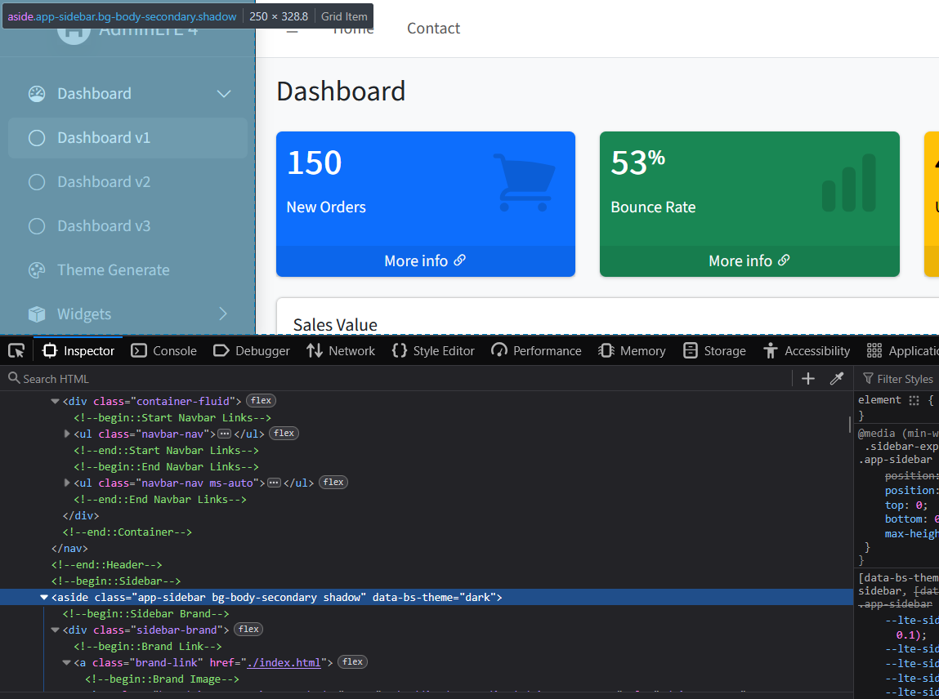
Layout Analysis: Sidebar
Use the Inspect Element help tool in each browser.
Sidebar on AdminLTE
The syntax or class declaring it left-menu is a
<aside class="app-sidebar bg-body-secondary shadow" data-bs-theme="dark">
Informatics Engineering | Universitas Surabaya

Slide 15
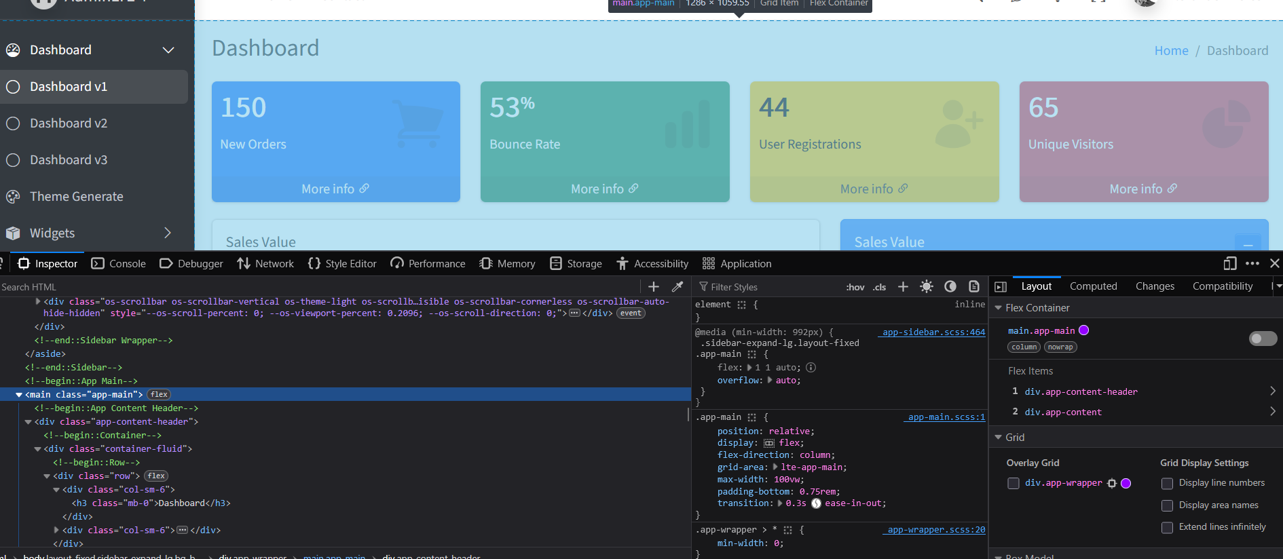
Layout Analysis: Content
Use the Inspect Element help tool in each browser.
The Content on AdminLTE was found as follows
The syntax or class that declares content is …
<main class="app-main">
Informatics Engineering | Universitas Surabaya

Slide 16
3. Identify Layout (Summary)
The AdminLTE Admin template has 3 parts, namely
Header
Sidebar
Content
When choosing a different menu, only the content section always show different content based on the selected menu.
When selecting a different menu, the 'sidebar' section has minor change in content. Only different CSS for the active menu
When choosing a different menu, the 'header' section has minor change
Hence, the ‘content' part must be sliced from the main layout
Informatics Engineering | Universitas Surabaya

Slide 17
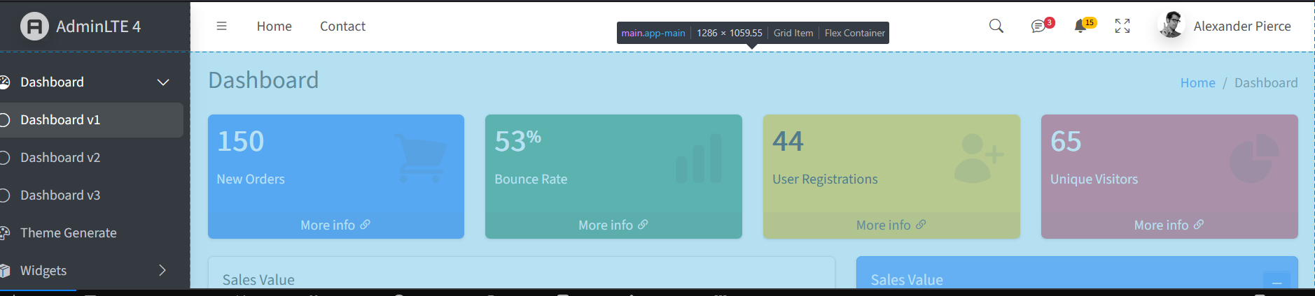
4. Define Base Layout and Child Layout
Based on the previous work steps, we can define:
Child Layout is the program snippet from the inside ‘content’
Base Layout is the entire HTML code of the 'index.html' file except ‘content’ section
Child Layout
Base Layout
Informatics Engineering | Universitas Surabaya

Slide 18
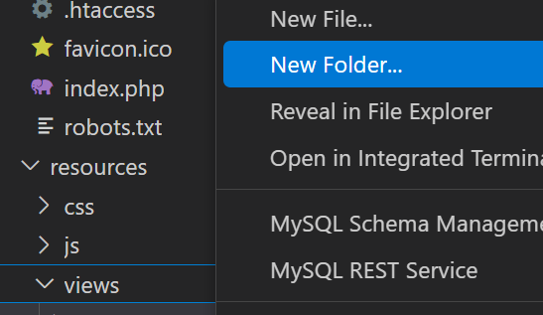
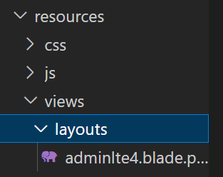
5. Apply Layouts and Child Templates on Laravel Resources View (1)
Create a folder called 'layouts' in resources/views
Informatics Engineering | Universitas Surabaya

Slide 19
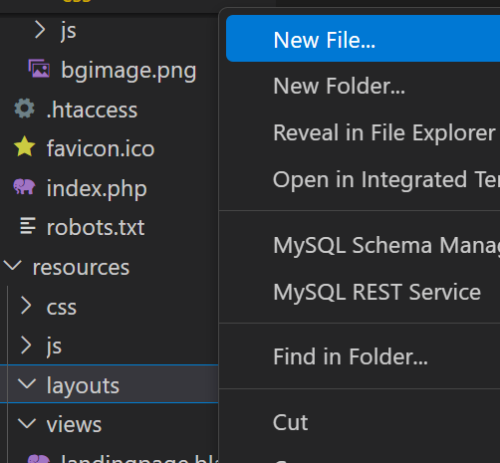
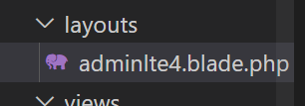
5. Apply Layouts and Child Templates on Laravel Resources View (2)
Create a new blade file. (extension: *.blade.php)
Filenames are basically free, but are recommended according to the `theme name`
Informatics Engineering | Universitas Surabaya

Slide 20
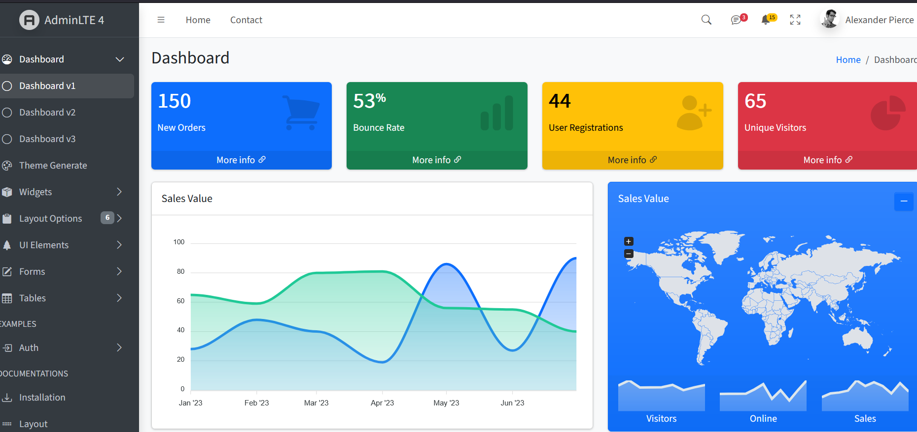
5. Apply Layouts and Child Templates on Laravel Resources View (3)
Copy all the HTML scripts in index.html and paste them into layouts `adminlte4.blade.php`
(see next slide) Move the `content` section and move script html into `child layout` (see next slide)
Informatics Engineering | Universitas Surabaya

Slide 21
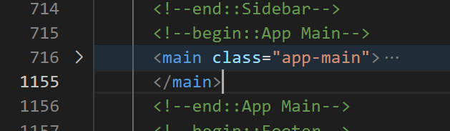
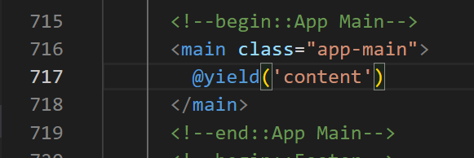
5. Apply Layouts and Child Templates on Laravel Resources View (4)
Collapse <main class> ‘page-content’ and remove
“….”. Because we substitute with @yield
Informatics Engineering | Universitas Surabaya

Slide 22
6. Integrate child layout with our `main template` using @yield, @section and @extends syntax
In the main-layout file, named `adminlte4.blade.php`, please add @yield('content’) near the red boxed (previous slide) to indicate that the section will be filled with a child.
In the beginning of child-layout file, programmer must create @section syntax to synchronize the child & main layout.
Inside the section of `child-layout` please paste the script content inside the red-boxed (from the previous slide) and modify the page title to make it more appropriate
Informatics Engineering | Universitas Surabaya

Slide 23
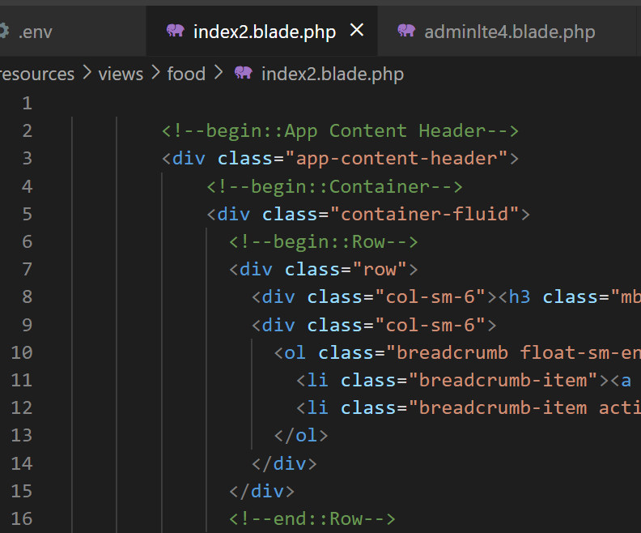
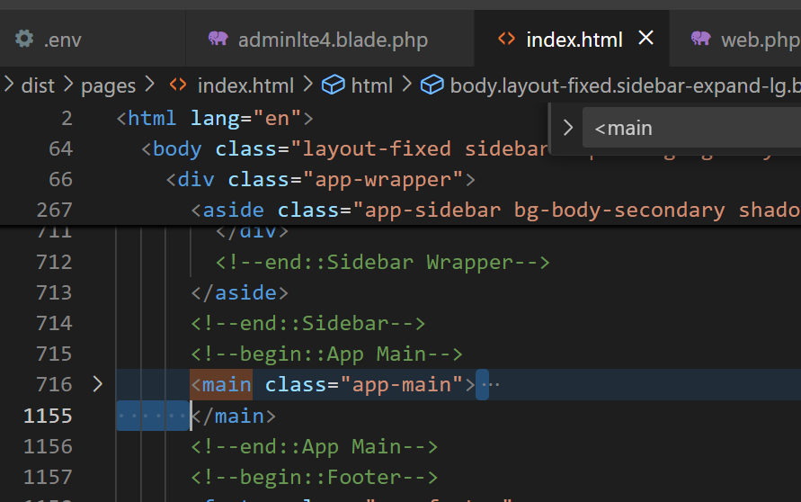
From your template, cut your content data
Cut (Ctrl+X)
New Child File
(ex: index2.blade.php)
Informatics Engineering | Universitas Surabaya

Slide 24
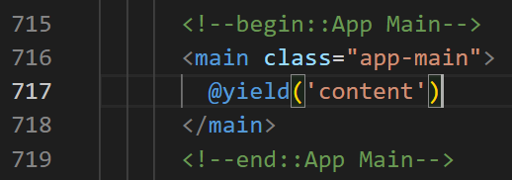
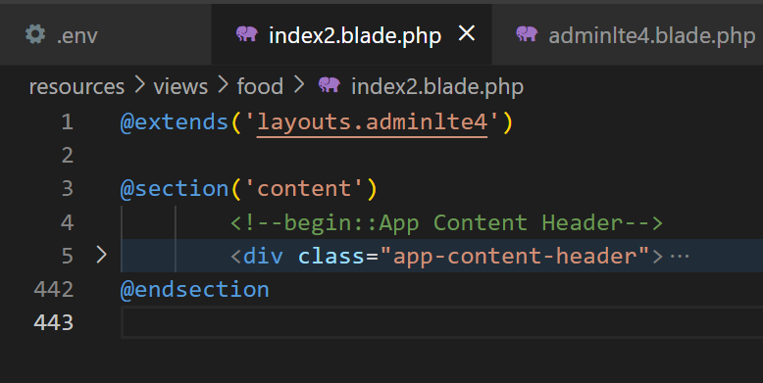
In adminlte4.blade.php
@extends('layouts.adminlte4’)
@section('content')
<!--begin::App Content Header-->
<div class="app-content-header">
…..
</div>
@endsection
Informatics Engineering | Universitas Surabaya

Slide 25
Practice #2: Implement the Template in Index of Food View
Informatics Engineering | Universitas Surabaya

Slide 26
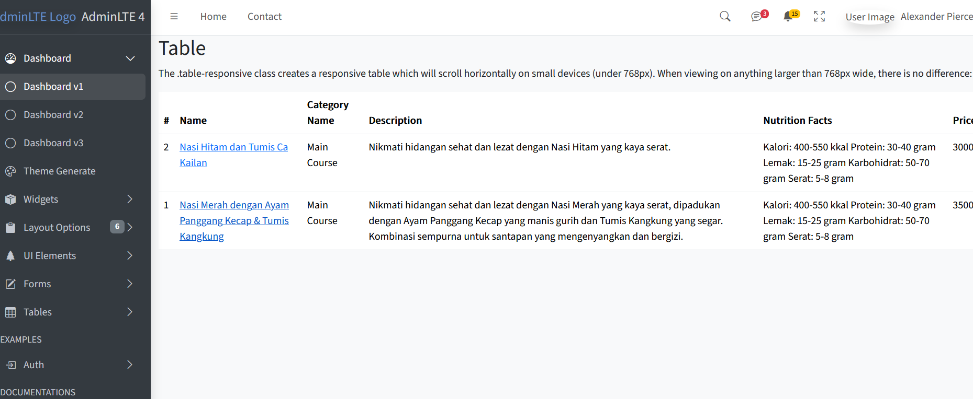
Adapt your Food/index.blade.php into your Template
Add @extends and @section
Also take the page-title and page-bar and modify it to fit the contents of the page
Expected Results :
Informatics Engineering | Universitas Surabaya

Slide 27
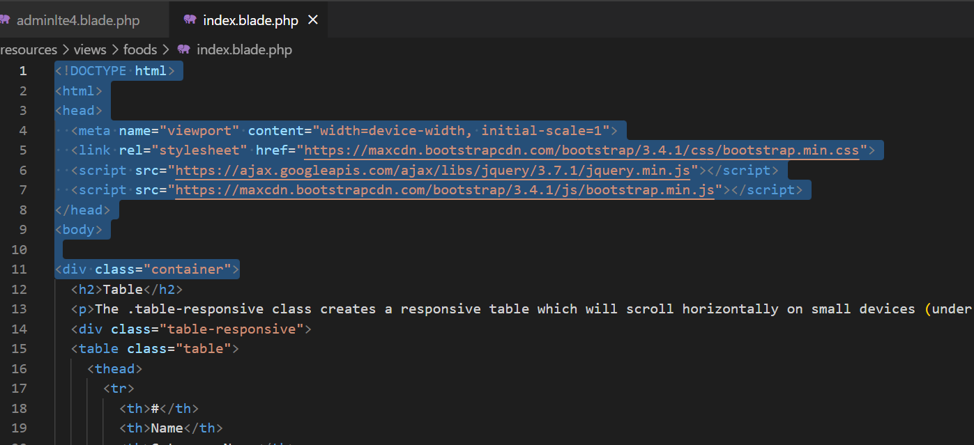
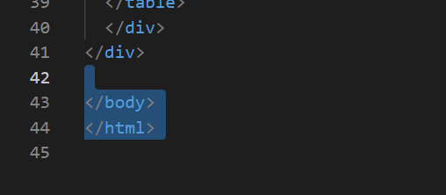
Remove non-essential content
Informatics Engineering | Universitas Surabaya

Slide 28
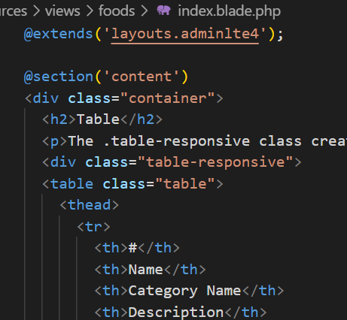
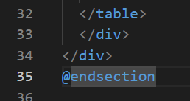
Apply Layouts and Child Templates in Laravel's Resources View
Extend the parent/base layout and add a section for the content.
Put your content script data inside the section(‘content’)
Informatics Engineering | Universitas Surabaya

Slide 29
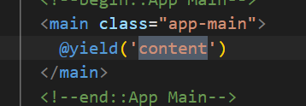
Integrate child templates with layout templates with @yield and @extends syntax
Don’t forget to check your `main-layout` and `child-layout` has similar name
Informatics Engineering | Universitas Surabaya

Slide 30
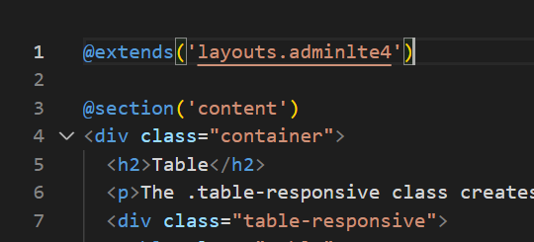
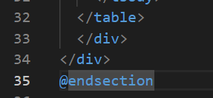
Integrate child templates with layout templates with @yield and @extends syntax (2)
In the child-layout file (eg: food/index.blade.php), it is written @extends and @section.
@extends has a layout name parameter that is used as a benchmark.
@extends is placed on top of the same as import in the controller file.
@section has a yield name parameter to be entered.
Informatics Engineering | Universitas Surabaya

Slide 31
Integrate child templates with layout templates with @yield and @extends syntax (3)
Add @section ('content') on the 3rd line (above the container-fluid class div because it indicates that from line 4 to @endsection will be pasted on @yield('content') in layouts.
. . .
Informatics Engineering | Universitas Surabaya

Slide 32
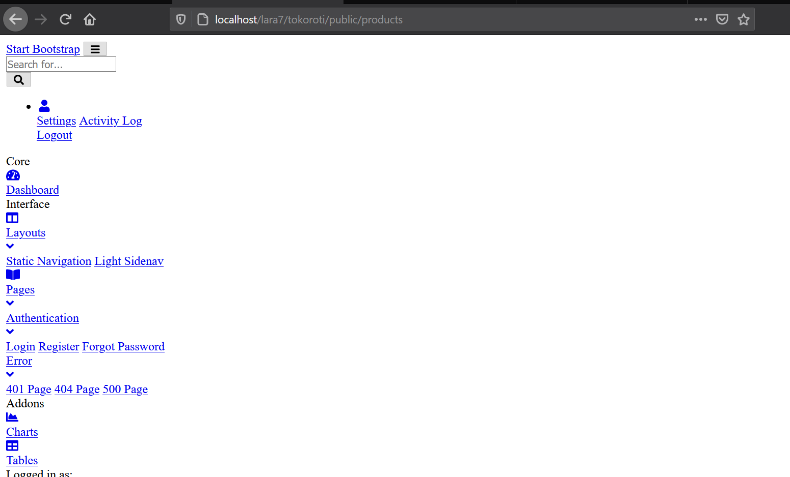
Result
Informatics Engineering | Universitas Surabaya

Slide 33
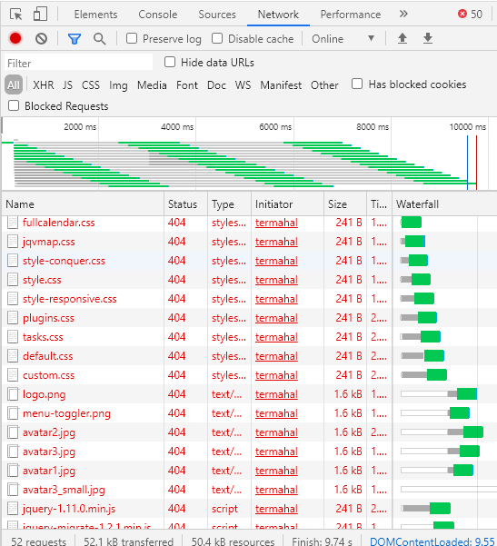
What’s wrong?
Your template isn’t load correctly. Please check your “Inspect Element” and “Network tab”.
This case caused by your asset template is missing.
The components of template are
Asset css
Asset js
Asset img
Informatics Engineering | Universitas Surabaya

Slide 34
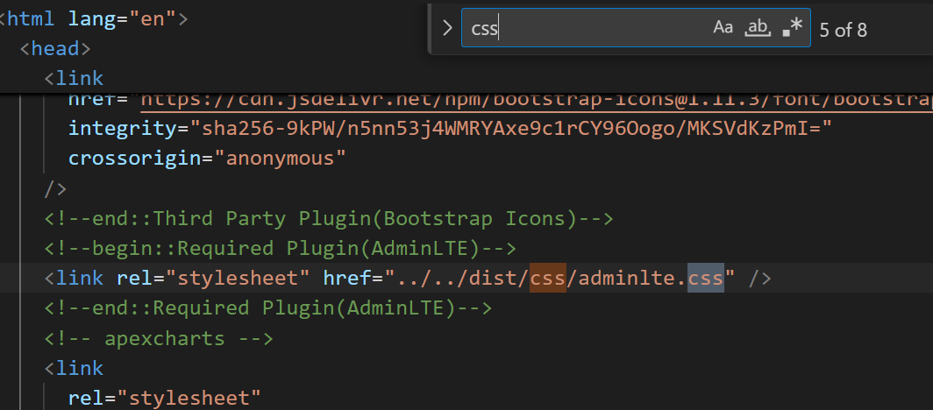
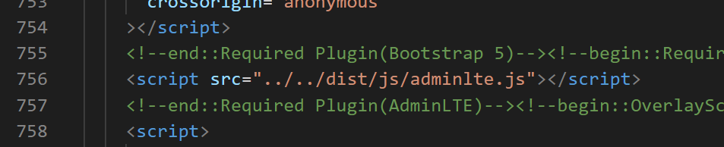
SOLUTION: Install Asset JS/CSS template with @asset syntax
The solution is type “asset()” function before and after `all import js/css/image` scripts in layouts template.
Usually import js/css scripts are located at the beginning (header) of html and footer of html
Informatics Engineering | Universitas Surabaya

Slide 35
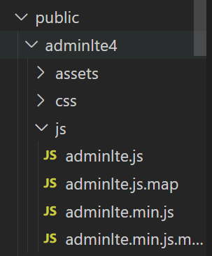
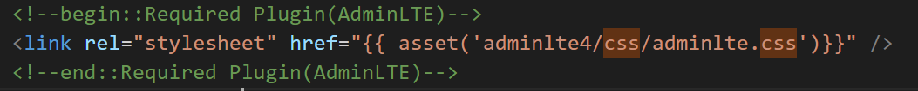
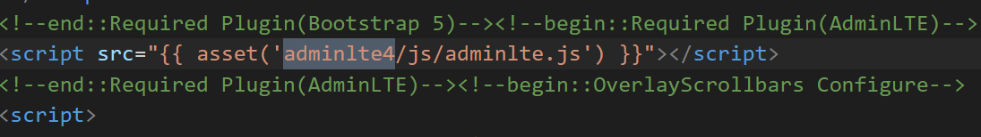
The Result is
Informatics Engineering | Universitas Surabaya

Slide 36
Practice #3: Updating the menu for links to other tables
Informatics Engineering | Universitas Surabaya

Slide 37
Workflow Development
Go to the script file that implements left-menu
Determine what links will appear in the menu
Find the URI from the menu in web.php or use the artisan syntax “php artisan route:list”
Use the syntax @route('route_name') or @url('path_url') where it goes
Informatics Engineering | Universitas Surabaya

Slide 38
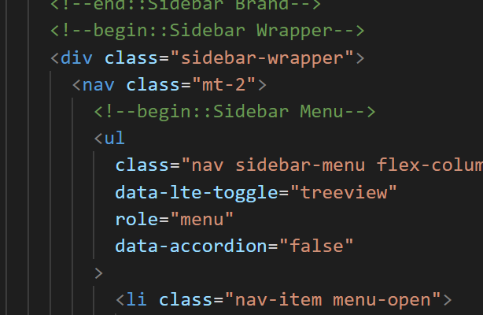
1. Go to the script file that implements left-menu
In the above case we go to layouts/adminlte4.blade.php on the <div class="sidebar-wrapper">
Informatics Engineering | Universitas Surabaya

Slide 39
2. Determine what links will appear in the menu
Modify the coding in this case by providing 2 menus, namely: Food, Category menus
In addition to the menu above, we will delete it.
Informatics Engineering | Universitas Surabaya

Slide 40
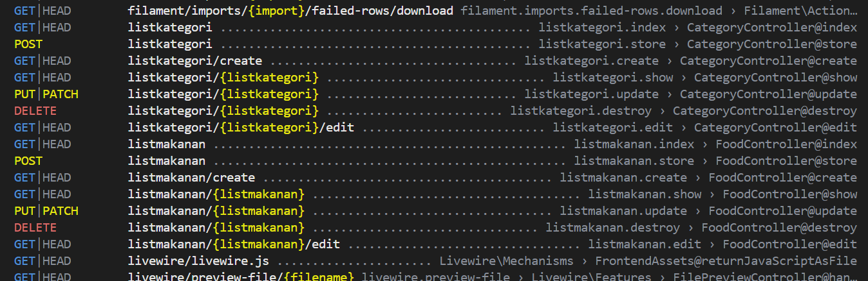
3. Find your URI from route:list
With php artisan route:list we are helped to find the link url or route name of the action to be displayed
Informatics Engineering | Universitas Surabaya

Slide 41
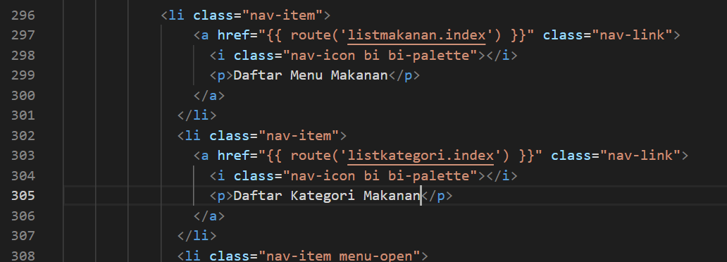
Add script -> route()
Remember @route and
@url is syntax
blade then must
given {{ … }}
Informatics Engineering | Universitas Surabaya

Slide 42
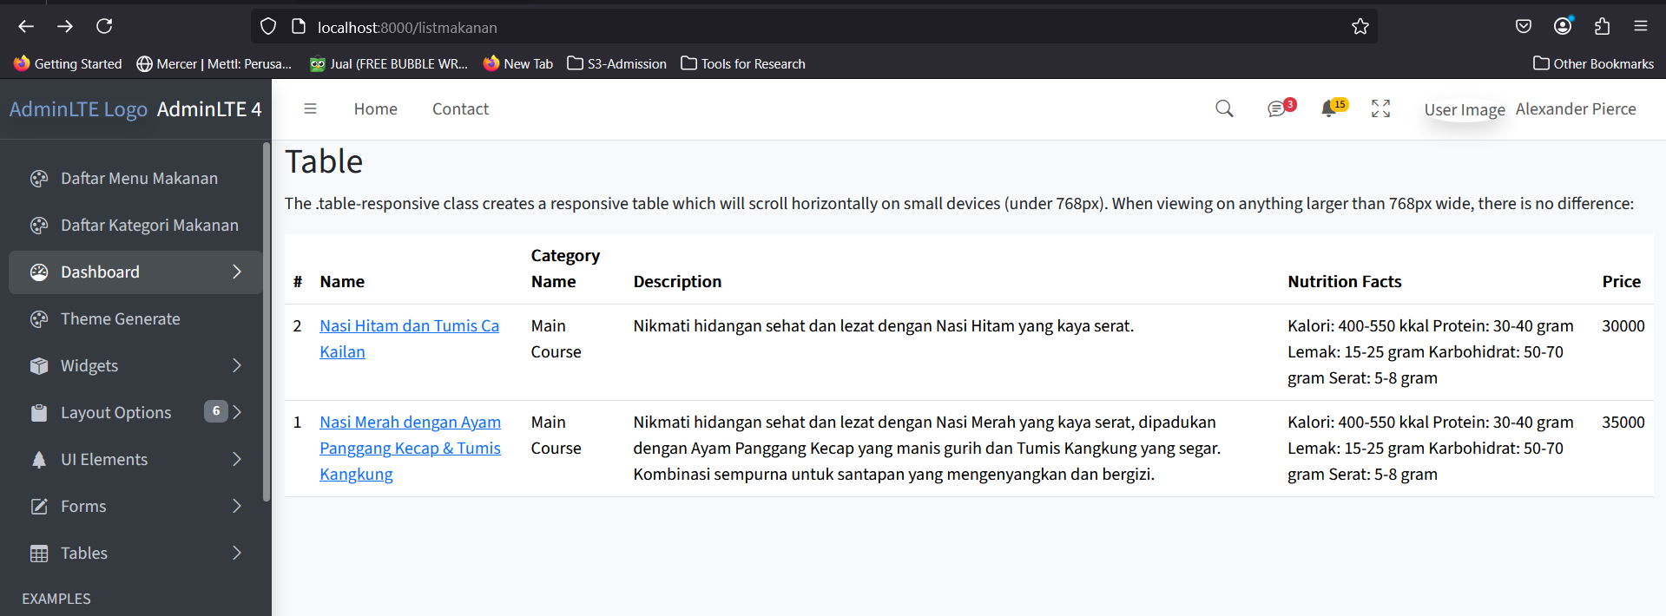
Result
Informatics Engineering | Universitas Surabaya

Slide 43
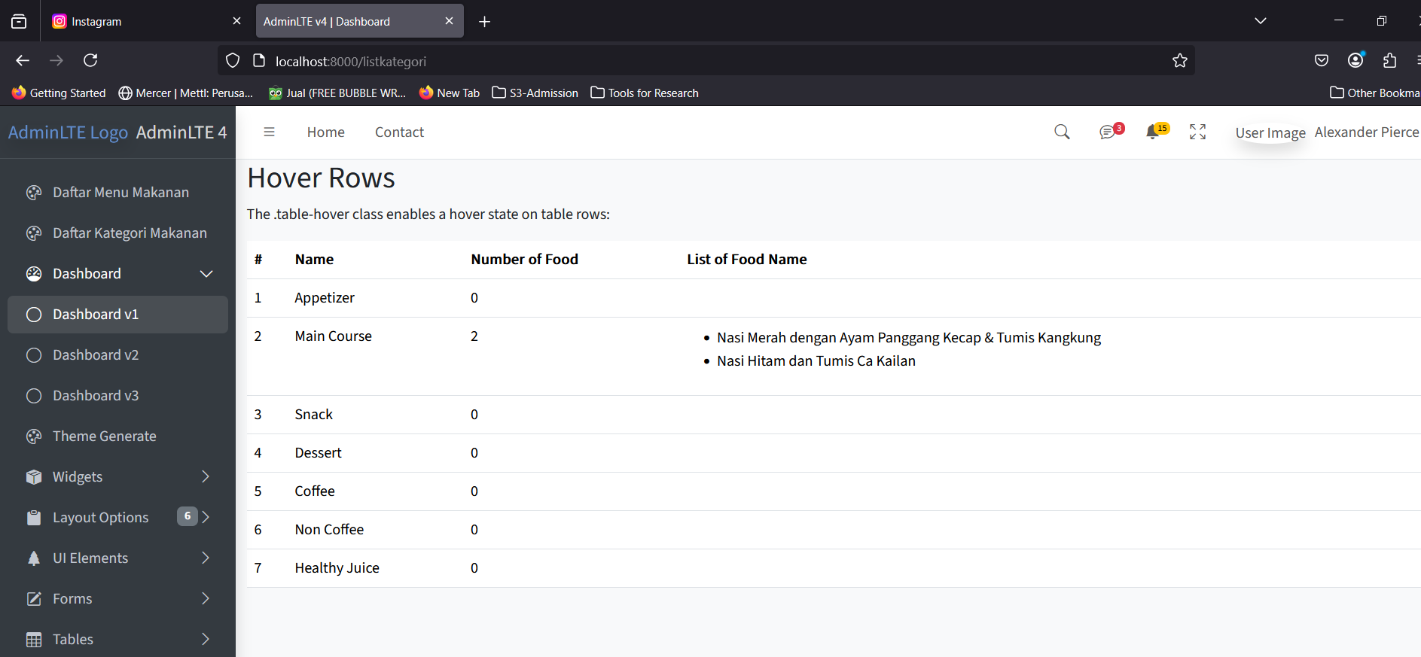

Slide 44
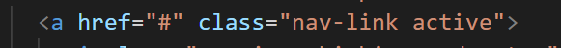
Your Task
#1. Modify all page of views and reports that you have created in previous tasks with new templates.
Food/Category/Customer/Order
All your Report
#2. Add menus in the sidebar to access those pages.
#3. Change each of title homepage with your current page (clue: add @yield(‘title’) at your layouts)
#4. Change active menu from your side-bar menu. (clue: add @yield(‘side-bar’) at your layouts and add “active” in side class)
Informatics Engineering | Universitas Surabaya

Slide 45
Thank You
Informatics Engineering | Universitas Surabaya

